Slide 1
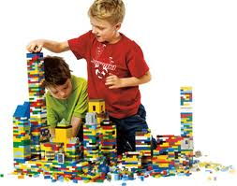
Learning
Acquiring new, or modifying existing, knowledge

Slide 2
Learning
Learning involves changes to the content and organization of a system’s knowledge enabling it to improve its performance on a particular task or set of tasks [Simon, 1981].
Learning occurs when the system requires new knowledge from its environment or when it organize its current knowledge to make better use of it.

Slide 3
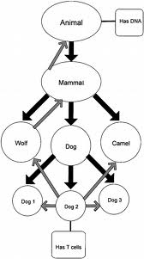
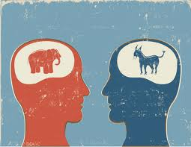
Inference
Inference is the act or process of deriving logical conclusions from premises /evidences.
Learning methods uses:
Deductive inference
Or
Inductive inference.

Slide 4
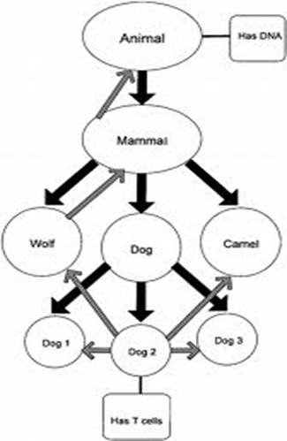
Deductive inference
If a conclusion is reached on the basis of a certain set of premises/examples.
The conclusion still holds if more premises are added.
Deductive inferences are used to improve the performance of automated reasoning system.
- Applied in Robotics
-in medical diagnosis e.t.c

Slide 5
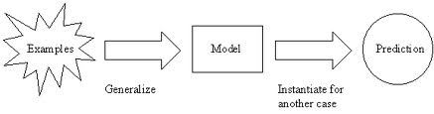
Inductive Inference
Inductive reasoning consists of inferring general principles or rules from specific facts. In other words, Ind-Inf arrives at general conclusions by examining particular examples.
Example:
90% of humans are right-handed.
Joe is a human.
Therefore, the probability that Joe is right-handed is 90%.

Slide 6
Inductive Inference (Cont.)
Inductive reasoning allows for the possibility that the conclusion may be false, even where all of the premises are true. Example is as follows:
All of the swans we have seen are white.
All swans are white.
A proper example of inductive reasoning is as follows:
All of the swans that all living beings have ever seen are white. Therefore, all swans are white.

Slide 7
Classifying Inductive Learning
Inductive learning methods make use of Statistical techniques.
Learning based on inductive inference can be divided into:
supervised learning
and
unsupervised learning.

Slide 8
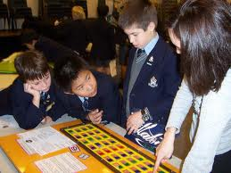
Supervised learning

Slide 9
An example application
An emergency room in a hospital measures 17 variables (e.g., blood pressure, age, etc) of newly admitted patients.
A decision is needed: whether to put a new patient in an intensive-care unit.
Due to the high cost of ICU, those patients who may survive less than a month are given higher priority.
Problem: to predict high-risk patients and discriminate them from low-risk patients.

Slide 10
Another application
A credit card company receives thousands of applications for new cards. Each application contains information about an applicant,
age
Marital status
annual salary
outstanding debts
credit rating
etc.
Problem: to decide whether an application should approved, or to classify applications into two categories, approved and not approved.

Slide 11
learning and our focus
Like human learning from past experiences.
A computer does not have “experiences”.
A computer system learns from data, which represent some “past experiences” of an application domain.
Our focus: learn a target function that can be used to predict the values of a discrete class attribute, e.g., approve or not-approved, and high-risk or low risk.
The task is commonly called: Supervised learning, classification, or inductive learning.

Slide 12
The data and the goal
Data: A set of data records (also called examples, instances or cases) described by
k attributes: A₁, A₂, … A_{k}.
a class: Each example is labelled with a pre-defined class ‘c’.
Goal: To learn a classification model from the data that can be used to predict the classes of new (future, or test) instances.
Notes:
Induction is different from deduction and DBMS does not not support induction;
The result of induction is higher-level information or knowledge: general statements about data
There are many approaches. Refer to the lecture notes for CS3244 available at the Co-Op.
We focus on three approaches here, other examples:
Other approaches
Instance-based learning
other neural networks
Concept learning (Version space, Focus, Aq11, …)
Genetic algorithms
Reinforcement learning

Slide 13
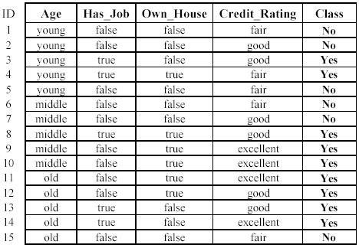
An example: data (loan application)
Approved or not

Slide 14
An example: the learning task
Learn a classification model from the data
Use the model to classify future loan applications into
Yes (approved) and
No (not approved)
What is the class for following case/instance?

Slide 15
Supervised Learning
Supervision: The data (observations, measurements, etc.) are labeled with pre-defined classes. It is like that a “teacher” gives the classes (supervision).
Test data are classified into these classes too.

Slide 16
E.g. Procedure of Labeling
Object_Marker

Slide 17
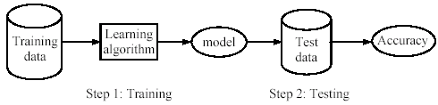
Supervised learning process: two steps
Learning (training): Learn a model using the training data
Testing: Test the model using unseen test data to assess the model accuracy

Slide 18
What do we mean by learning?
Given
a data set D,
a task T, and
a performance measure M,
a computer system is said to learn from D to perform the task T if after learning the system’s performance on T improves as measured by M.
In other words, the learned model helps the system to perform T better as compared to no learning.

Slide 19
An example
Data: Loan application data
Task: Predict whether a loan should be approved or not.
Performance measure: accuracy.
No learning: classify all future applications (test data) to the majority class (i.e., Yes):
Accuracy = 9/15 = 60%.
We can do better than 60% with learning.

Slide 20
Fundamental assumption of learning
Assumption: The distribution of training examples is identical to the distribution of test examples (including future unseen examples).
In practice, this assumption is often violated to certain degree.
Strong violations will clearly result in poor classification accuracy.
To achieve good accuracy on the test data, training examples must be sufficiently representative of the test data.

Slide 21
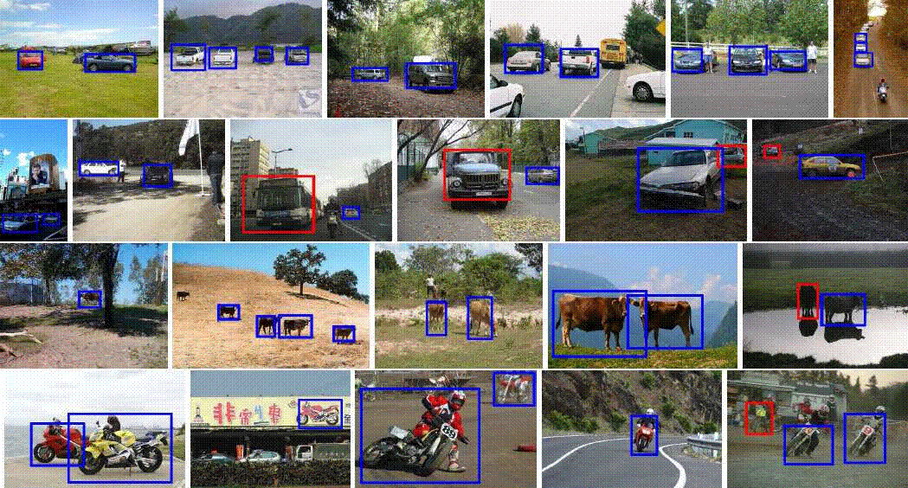
Demo
Object-detection
Supervised method

Slide 22

Evaluating classification methods
Predictive accuracy
Efficiency
time to construct the model
time to use the model
Robustness: handling noise and missing values
Interpretability:
understandable and insight provided by the model
Compactness of the model: size of the tree, or the number of rules (or assumptions).

Slide 23
Evaluation methods
Following four methods commonly used to evaluate trained model/ classifier, based on size of available (training ) data.
Holdout set
n-fold cross-validation
Leave-one-out cross-validation
Validation set

Slide 24
Evaluation methods
Holdout set: The available data set D is divided into two disjoint subsets,
the training set D_{train} (for learning a model)
the test set D_{test} (for testing the model)
Important: training set should not be used in testing and the test set should not be used in learning.
Unseen test set provides a unbiased estimate of accuracy.
The test set is also called the holdout set. (the examples in the original data set D are all labeled with classes.)
This method is mainly used when the data set D is large.

Slide 25
Evaluation methods (cont…)
n-fold cross-validation: The available data is partitioned into n equal-size disjoint subsets.
Use each subset as the test set and combine the rest n-1 subsets as the training set to learn a classifier.
The procedure is run n times, which give n accuracies.
The final estimated accuracy of learning is the average of the n accuracies.
10-fold and 5-fold cross-validations are commonly used.
This method is used when the available data is not large.

Slide 26
Evaluation methods (cont…)
Leave-one-out cross-validation: This method is used when the data set is very small.
It is a special case of cross-validation
Each fold of the cross validation has only a single test example and all the rest of the data is used in training.
If the original data has m examples, this is m-fold cross-validation

Slide 27
Evaluation methods (cont…)
Validation set: the available data is divided into three subsets,
a training set,
a validation set and
a test set.
A validation set is used frequently for estimating parameters in learning algorithms.
In such cases, the values that give the best accuracy on the validation set are used as the final parameter values.
Cross-validation can be used for parameter estimating as well.

Slide 28
Classification measures
In Bioinformatics and machine learning in general, there is a large variation in the measures that are used to evaluate prediction systems. Following are the common techniques used to classification measure.
Precision and recall measures
F₁-value (measure)
Confusion matrix
Receiver operating characteristic (ROC)
The class of interest is commonly called the positive class, and the rest negative classes.

Slide 29
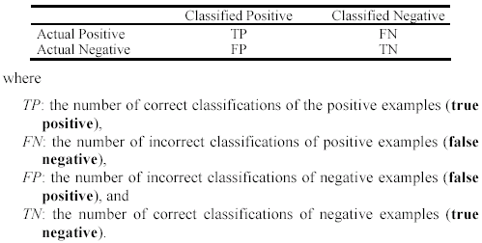
Precision and recall measures
Used in information retrieval and text classification.
We use a confusion matrix to introduce them.

Slide 30

Precision and recall measures (cont…)
Precision p is the number of correctly classified positive examples divided by the total number of examples that are classified as positive (by the classifier).
Recall r is the number of correctly classified positive examples divided by the total number of actual positive examples in the test set (either detected or mised).

Slide 31
Precision and recall measures An example
Efficiency of the learnt model is evaluated using test video with 35 test images, manually annotated 90 samples as test data.

Slide 32

Another example
This confusion matrix gives
precision p = 100% and
recall r = 1%
because we only classified one positive example correctly and no negative examples wrongly.
Note: precision and recall only measure classification on the positive class.

Slide 33
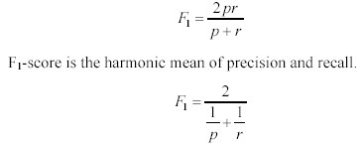
F₁-value (also called F₁-score)
It is hard to compare two classifiers using two measures. F₁ score combines precision and recall into one measure
The harmonic mean of two numbers tends to be closer to the smaller of the two.
For F₁-value to be large, both p and r much be large.

Slide 34
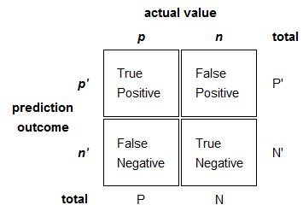
Confusion matrix
In the field of AI, a confusion matrix is a specific table layout that allows visualization of the performance of an algorithm, typically used in supervised learning. In unsupervised learning it is usually called a matching matrix.
Each column of the matrix represents the instances in a predicted class, while each row represents the instances in an actual class. The name stems from the fact that it makes it easy to see if the system is confusing two classes (i.e. commonly mislabeling one as another).

Slide 35
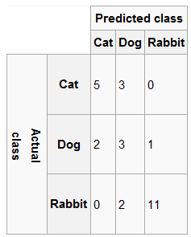
An example confusion matrix

Slide 36
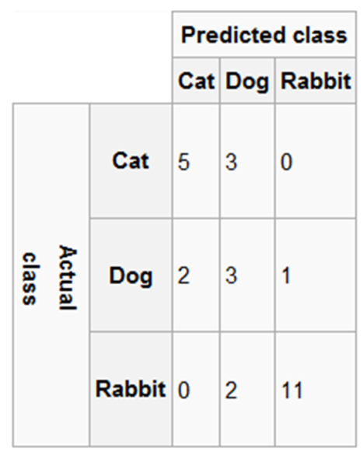
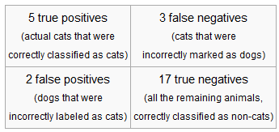
confusion matrix
In the confusion matrix above, its corresponding table of confusion, for the cat class, would be:

Slide 37
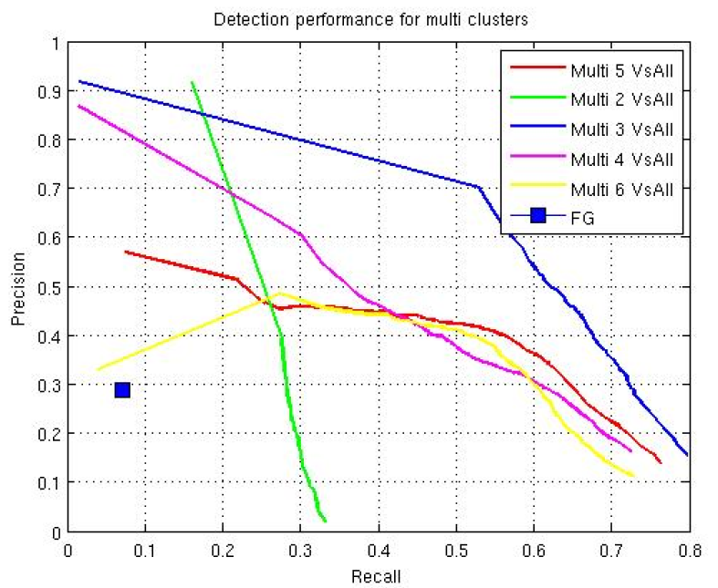
ROC curve
ROC curve, is a graphical plot of the sensitivity, or true positive rate, vs. false positive rate (one minus the specificity or true negative rate), for a binary classifier system as its discrimination threshold is varied.

Slide 38
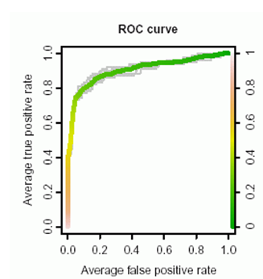
ROC curve (Cont.)
The ROC can also be represented equivalently by plotting the fraction of true positives out of the positives (TPR = true positive rate) vs. the fraction of false positives out of the negatives (FPR = false positive rate). The ROC is also known as a Relative Operating Characteristic

